Slide 1

Test Strategy and Test Plan

Slide 2

How was your self-study?
Types of Testing?
Testing Levels?
Homework discussion

Slide 3
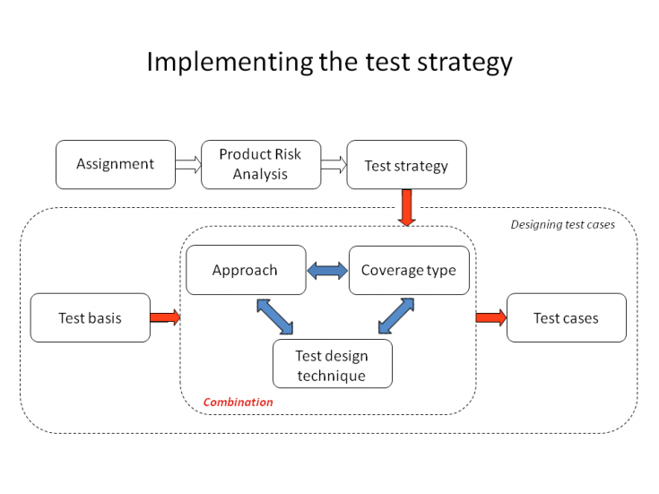
Test Strategy
The Oxford Dictionary defines Strategy as “… a plan designed to achieve a particular long-term aim”.
As usual it is long-terms plan for testing methodology, tools for testing and testing processes implementation within 1 big-term project or whole QA department.

Slide 4

Test Plan
A Test Plan describes the “How” at a lower level.
IEEE 829 (on which there is much debate on the revision currently being voted on) introduces the structure of should be incorporated in the plan. It is comparable to tactics which again according the Oxford Dictionary is “… an action or strategy planned to achieve a specific end.”
Test Plans: Master Test Plan, Acceptance Test Plan, etc.

Slide 5
Test Plan Structure [IEEE 829]
Test Plan identifier
Introduction
Test items
Feature to be tested
Feature not to be tested
Approach
Item pass/fail criteria
Suspension criteria and resumption requirements
Test deliverables
Testing tasks
Environmental needs
Responsibilities
Staffing and training needs
Schedule
Risks and contingencies
Approvals

Slide 6
Test Plan Identifier
Some type of unique company generated number to identify this test plan, its level and the level of software that it is related to. Preferably the test plan level will be the same as the related software level. The number may also identify whether the test plan is a Master plan, a Level plan, an integration plan or whichever plan level it represents. This is to assist in coordinating software and testware versions within configuration management.
Keep in mind that test plans are like other software documentation, they are dynamic in nature and must be kept up to date. Therefore, they will have revision numbers.
You may want to include author and contact information including the revision history information as part of either the identifier section of as part of the introduction.

Slide 7
Introduction
State the purpose of the Plan, possibly identifying the level of the plan (master etc.). This is essentially the executive summary part of the plan.
You may want to include any references to other plans, documents or items that contain information relevant to this project/process. If preferable, you can create a references section to contain all reference documents.
Identify the Scope of the plan in relation to the Software Project plan that it relates to. Other items may include, resource and budget constraints, scope of the testing effort, how testing relates to other evaluation activities (Analysis & Reviews), and possible the process to be used for change control and communication and coordination of key activities.
As this is the "Executive Summary" keep information brief and to the point.

Slide 8
Test Items
These are things you intend to test within the scope of this test plan. Essentially, something you will test, a list of what is to be tested. This can be developed from the software application inventories as well as other sources of documentation and information.
This can be controlled and defined by your local Configuration Management (CM) process if you have one. This information includes version numbers, configuration requirements where needed, (especially if multiple versions of the product are supported). It may also include key delivery schedule issues for critical elements.
Remember, what you are testing is what you intend to deliver to the Client.
This section can be oriented to the level of the test plan. For higher levels it may be by application or functional area, for lower levels it may be by program, unit, module or build.

Slide 9
Features to be Tested
This is a listing of what is to be tested from the USERS viewpoint of what the system does. This is not a technical description of the software, but a USERS view of the functions.
Set the level of risk for each feature. Use a simple rating scale such as (H, M, L): High, Medium and Low. These types of levels are understandable to a User. You should be prepared to discuss why a particular level was chosen.
It should be noted that Section 4 and Section 6 are very similar. The only true difference is the point of view. Section 4 is a technical type description including version numbers and other technical information and Section 6 is from the Users viewpoint. Users do not understand technical software terminology; they understand functions and processes as they relate to their jobs.

Slide 10
Features not to be Tested
This is a listing of what is NOT to be tested from both the Users viewpoint of what the system does and a configuration management/version control view. This is not a technical description of the software, but a USERS view of the functions.
Identify WHY the feature is not to be tested, there can be any number of reasons.
Not to be included in this release of the Software.
Low risk, has been used before and is considered stable.
Will be released but not tested or documented as a functional part of the release of this version of the software.
Sections 6 and 7 are directly related to Sections 5 and 17. What will and will not be tested are directly affected by the levels of acceptable risk within the project, and what does not get tested affects the level of risk of the project.

Slide 11
Approach
This is your overall test strategy for this test plan; it should be appropriate to the level of the plan (master, acceptance, etc.) and should be in agreement with all higher and lower levels of plans. Overall rules and processes should be identified.
Are any special tools to be used and what are they?
Will the tool require special training?
What metrics will be collected?
Which level is each metric to be collected at?
How is Configuration Management to be handled?
How many different configurations will be tested?
Hardware
Software
Combinations of HW, SW and other vendor packages
What levels of regression testing will be done and how much at each test level?
Will regression testing be based on severity of defects detected?
How will elements in the requirements and design that do not make sense or are untestable be processed?
How will meetings and other organizational processes be handled?

Slide 12
Item Pass/Fail Criteria
What are the Completion criteria for this plan? This is a critical aspect of any test plan and should be appropriate to the level of the plan.
At the Unit test level this could be items such as:
All test cases completed.
A specified percentage of cases completed with a percentage containing some number of minor defects.
Code coverage tool indicates all code covered.
At the Master test plan level this could be items such as:
All lower level plans completed.
A specified number of plans completed without errors and a percentage with minor defects.
This could be an individual test case level criterion or a unit level plan or it can be general functional requirements for higher level plans.
What is the number and severity of defects located?

Slide 13
Suspension Criteria and Resumption Requirements
Know when to pause in a series of tests.
If the number or type of defects reaches a point where the follow on testing has no value, it makes no sense to continue the test; you are just wasting resources.
Specify what constitutes stoppage for a test or series of tests and what is the acceptable level of defects that will allow the testing to proceed past the defects.
Testing after a truly fatal error will generate conditions that may be identified as defects but are in fact ghost errors caused by the earlier defects that were ignored.

Slide 14
Test Deliverables
What is to be delivered as part of this plan?
Test plan document.
Test cases.
Test design specifications.
Tools and their outputs.
Simulators.
Static and dynamic generators.
Error logs and execution logs.
Problem reports and corrective actions.
One thing that is not a test deliverable is the software itself that is listed under test items and is delivered by development.

Slide 15
Remaining Test Tasks
If this is a multi-phase process or if the application is to be released in increments there may be parts of the application that this plan does not address. These areas need to be identified to avoid any confusion should defects be reported back on those future functions. This will also allow the users and testers to avoid incomplete functions and prevent waste of resources chasing non-defects.
If the project is being developed as a multi-party process, this plan may only cover a portion of the total functions/features. This status needs to be identified so that those other areas have plans developed for them and to avoid wasting resources tracking defects that do not relate to this plan.
When a third party is developing the software, this section may contain descriptions of those test tasks belonging to both the internal groups and the external groups.

Slide 16
Environmental Needs
Are there any special requirements for this test plan, such as:
Special hardware such as simulators, static generators etc.
How will test data be provided. Are there special collection requirements or specific ranges of data that must be provided?
How much testing will be done on each component of a multi-part feature?
Special power requirements.
Specific versions of other supporting software.
Restricted use of the system during testing.

Slide 17

Staffing and Training needs
Training on the application/system.
Training for any test tools to be used.

Slide 18
Responsibilities
Who is in charge?
This issue includes all areas of the plan. Here are some examples:
Setting risks.
Selecting features to be tested and not tested.
Setting overall strategy for this level of plan.
Ensuring all required elements are in place for testing.
Providing for resolution of scheduling conflicts, especially, if testing is done on the production system.
Who provides the required training?
Who makes the critical go/no go decisions for items not covered in the test plans?

Slide 19
Schedule
Should be based on realistic and validated estimates. If the estimates for the development of the application are inaccurate, the entire project plan will slip and the testing is part of the overall project plan.
As we all know, the first area of a project plan to get cut when it comes to crunch time at the end of a project is the testing. It usually comes down to the decision, Lets put something out even if it does not really work all that well. And, as we all know, this is usually the worst possible decision.
How slippage in the schedule will to be handled should also be addressed here.
If the users know in advance that a slippage in the development will cause a slippage in the test and the overall delivery of the system, they just may be a little more tolerant, if they know its in their interest to get a better tested application.
By spelling out the effects here you have a chance to discuss them in advance of their actual occurrence. You may even get the users to agree to a few defects in advance, if the schedule slips.

Slide 20
Risks and Contingencies
What are the overall risks to the project with an emphasis on the testing process?
Lack of personnel resources when testing is to begin.
Lack of availability of required hardware, software, data or tools.
Late delivery of the software, hardware or tools.
Delays in training on the application and/or tools.
Changes to the original requirements or designs.
Management is usually reluctant to accept scenarios such as the one above even though they have seen it happen in the past.
The important thing to remember is that, if you do nothing at all, the usual result is that testing is cut back or omitted completely, neither of which should be an acceptable option.

Slide 21
Approvals
Who can approve the process as complete and allow the project to proceed to the next level (depending on the level of the plan)?
At the master test plan level, this may be all involved parties.
When determining the approval process, keep in mind who the audience is:
The audience for a unit test level plan is different than that of an integration, system or master level plan.
The levels and type of knowledge at the various levels will be different as well.
Programmers are very technical but may not have a clear understanding of the overall business process driving the project.
Users may have varying levels of business acumen and very little technical skills.
Always be wary of users who claim high levels of technical skills and programmers that claim to fully understand the business process. These types of individuals can cause more harm than good if they do not have the skills they believe they possess.

Slide 22
Hometask
Read article about standards (ISTQB): https://www.istqb.org/images/Articles/veenendaal_Standards%20to%20be%20used%20with%20common%20sense!.pdf

